Slide 1
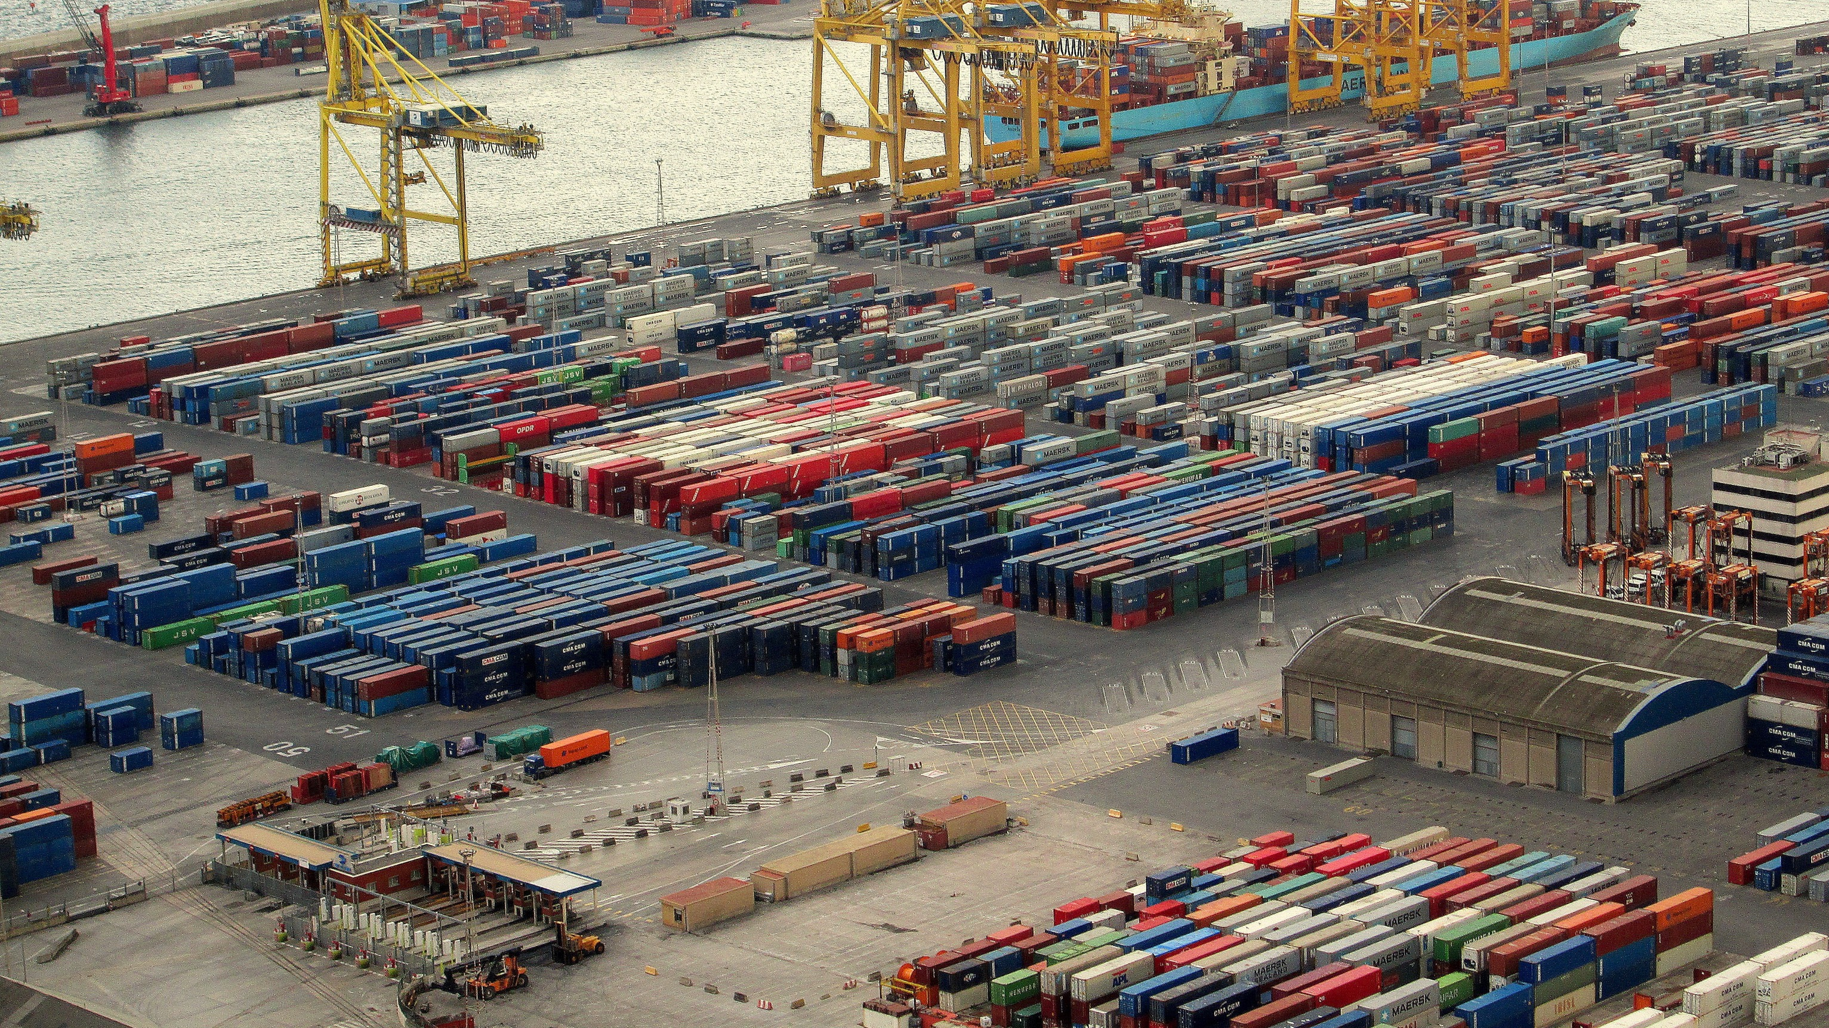


Volume of trading in Saudi Arabia
Ahmad Abusabaeen
3/5/2021

Slide 2
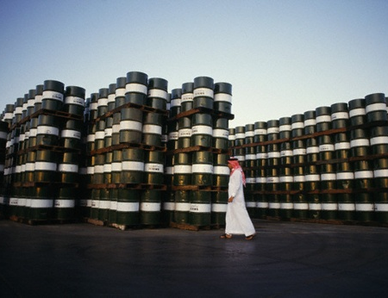

Introduction
What does Saudi Arabia export the most?
What is the ratio of oil exports to non-oil exports?
This Photo by Unknown Author is licensed under CC BY

Slide 3

Outline
Introduction
Volume of Saudi exports
Top Saudi exports
Volume of Saudi imports
Top Saudi imports
Statistical Trends
Conclusion
This Photo by Unknown Author is licensed under CC BY-NC-ND

Slide 4
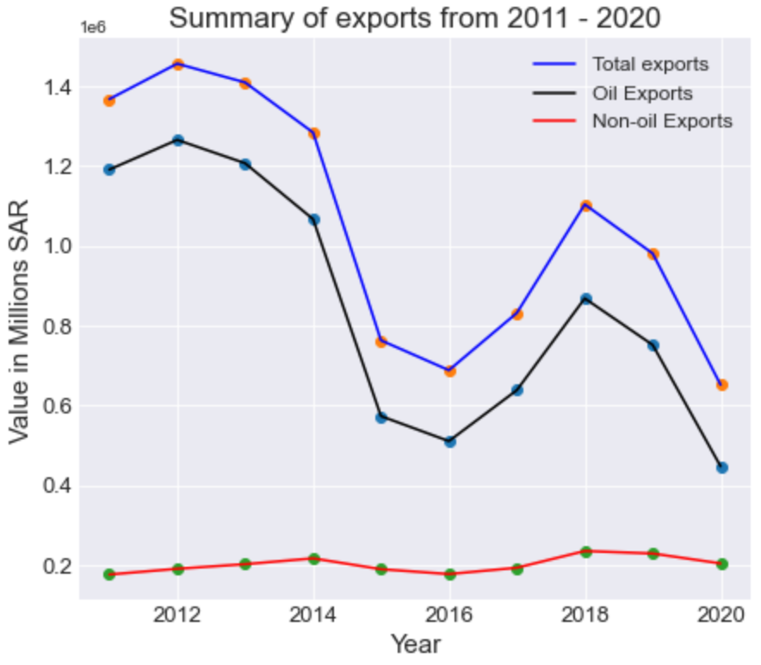
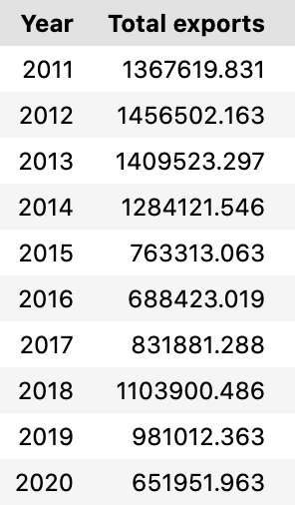
Volume of Saudi exports
Oil exports from 2011 - 2020 is %81 of total exports (SAR 8,521,187 m).
Non-Oil exports from 2011 - 2020 is (SAR 2,017,061 m)
A big drop of exports after 2014
Notes:
How much does the oil exports add to the Saudi economy?

Slide 5
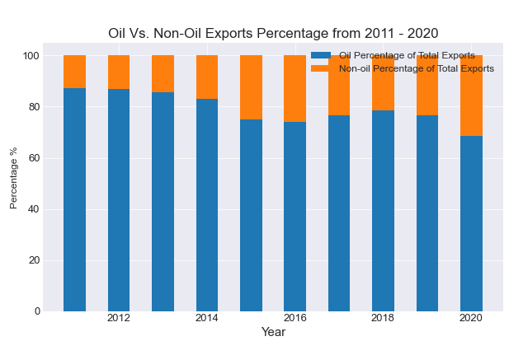
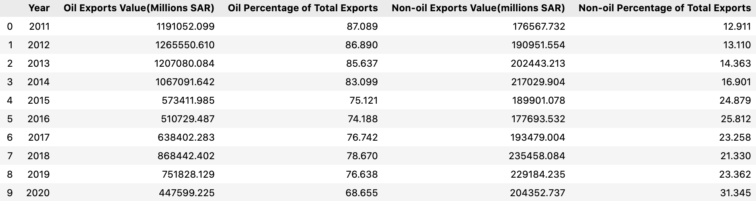
Top Saudi exports
Oil
Oil exports from 2011 - 2020 is %81 of total exports (SAR 8,521,187 x m).
Big drop of oil exports VALUE after 2014
Notes:
Starting to recover in 2018

Slide 6
Oil Exports
Highest was in 2012 = SAR 1,265,551 m
Lowest was in 2016 = SAR 510,723 m

Slide 7
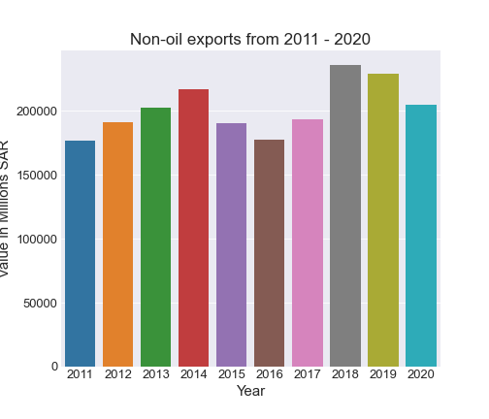
Non-Oil exports
2011 – 2021 Total = SAR 2,291,962 m
2021 = SAR 274,901 m
2020 = SAR 204,353 m
2019 = SAR 229,184 m
2018 = SAR 235,458 m

Slide 8
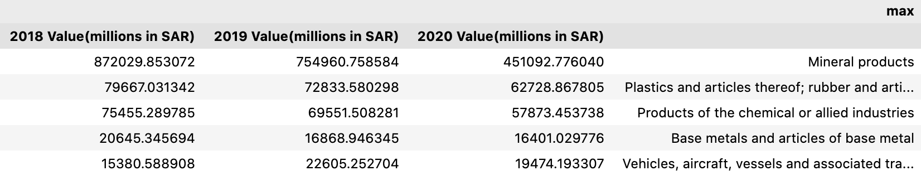
Non-Oil exports
Are the non-oil exports increasing?
Not crude oil, but some are affiliated to oil
Mean= SAR 201,706 m
2018 = SAR 235,458 m
Since 2018:
Mineral Products (percentage of overall in the years)
Plastics
Chemicals

Slide 9
Volume of Saudi imports
Sum of imports
2021 = 578,141 m SAR
2020 = 517,491 m SAR
2019 = 574,361 m SAR
2018 = 513,992 m SAR

Slide 10
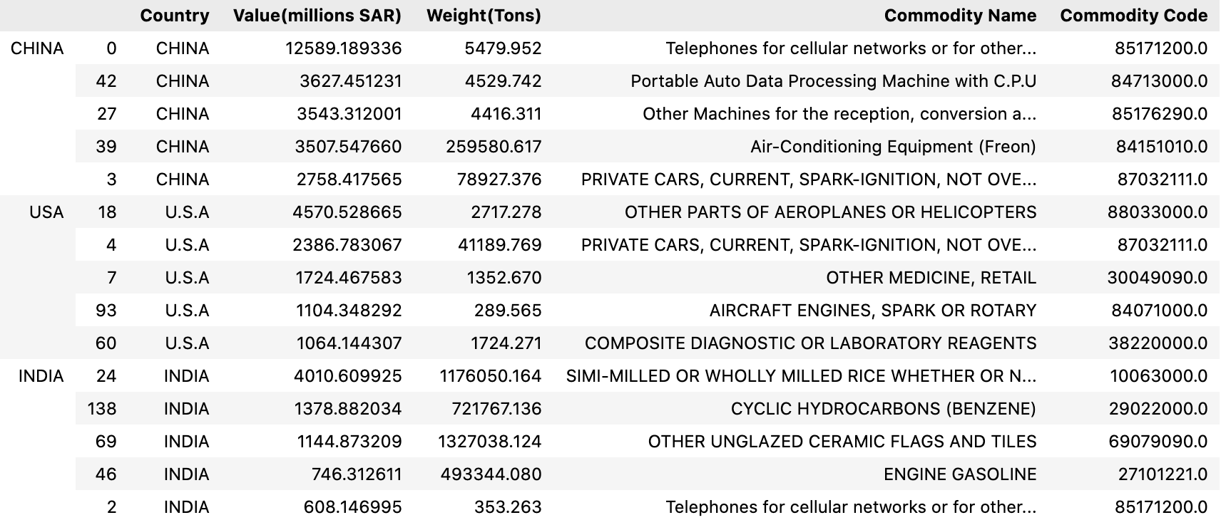
Top Saudi imports in 2020
By Tons:
China, United States, and India

Slide 11
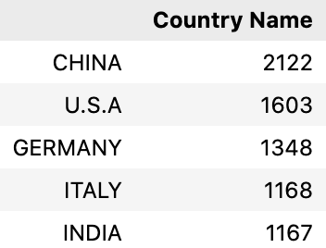
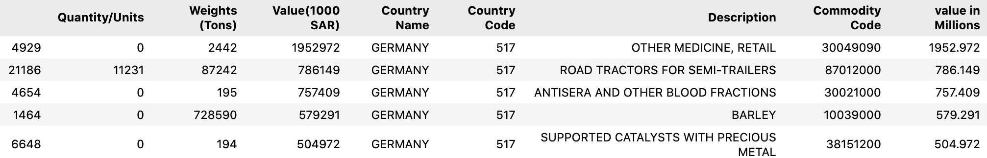
Top Saudi imports in 2020
By number of Commodities:
China, United States, and Germany

Slide 12
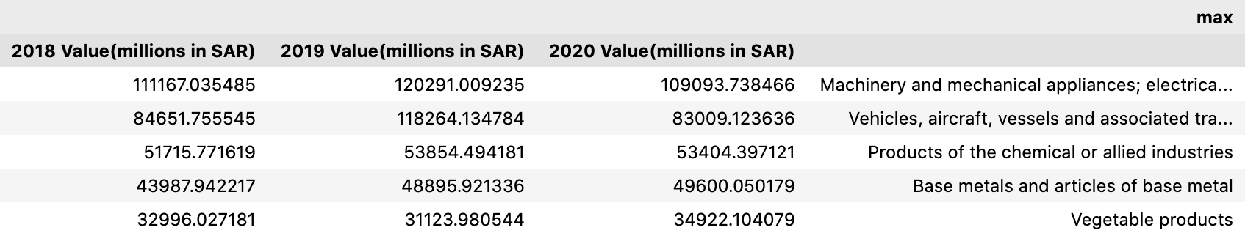
Top Saudi imports 2018-2020
Sum of imports
2018 Value(millions in SAR) 513992.690199
2019 Value(millions in SAR) 574361.454604
2020 Value(millions in SAR) 517490.594270

Slide 13
Statistical Trends

Slide 14
Conclusion

Slide 15
References
https://www.datacamp.com/community/tutorials/joining-dataframes-pandas?utm_source=adwords_ppc&utm_medium=cpc&utm_campaignid=1455363063&utm_adgroupid=65083631748&utm_device=c&utm_keyword=&utm_matchtype=&utm_network=g&utm_adpostion=&utm_creative=332602034358&utm_targetid=aud-299261629574:dsa-429603003980&utm_loc_interest_ms=&utm_loc_physical_ms=9076782&gclid=Cj0KCQiA64GRBhCZARIsAHOLriJSD4EDpEONsNz2t5vVxJNO_KPls4ktLMUG84pZq5K2n9SgY_AgZ1gaAphnEALw_wcB

